Slide 1


Connect City – Promoting the Smart Future
Group:2
Anas Mohamed
Amna Ahmed
Fatma Walid
Mariam Ahmed
Mahmoud Kotb

Slide 2

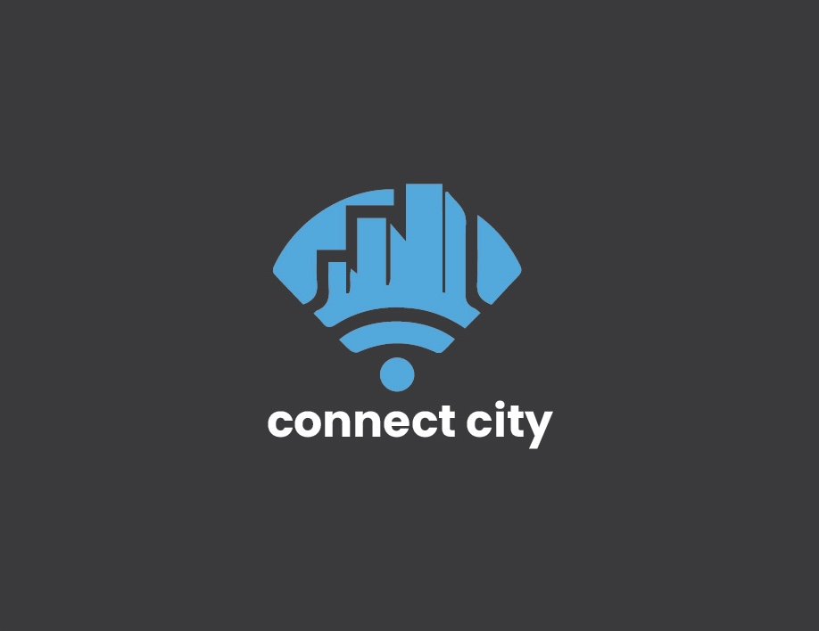

A minimalist logo combining a city skyline and Wi-Fi signal to represent connectivity and smart infrastructure in urban environments.

Slide 3


Our Goal objective of the Project:
To raise awareness about smart cities
To create a strong visual identity for the campaign
To promote smart living in an easy and modern way

Slide 4

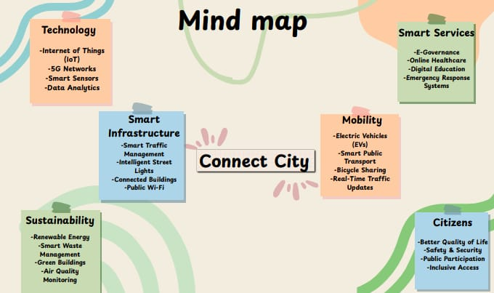



Slide 5
"Connect City"
Why the name "Connect City"?
Reflects technology, connection, and city life
Easy to understand and remember
Fits well with modern urban living

Slide 6
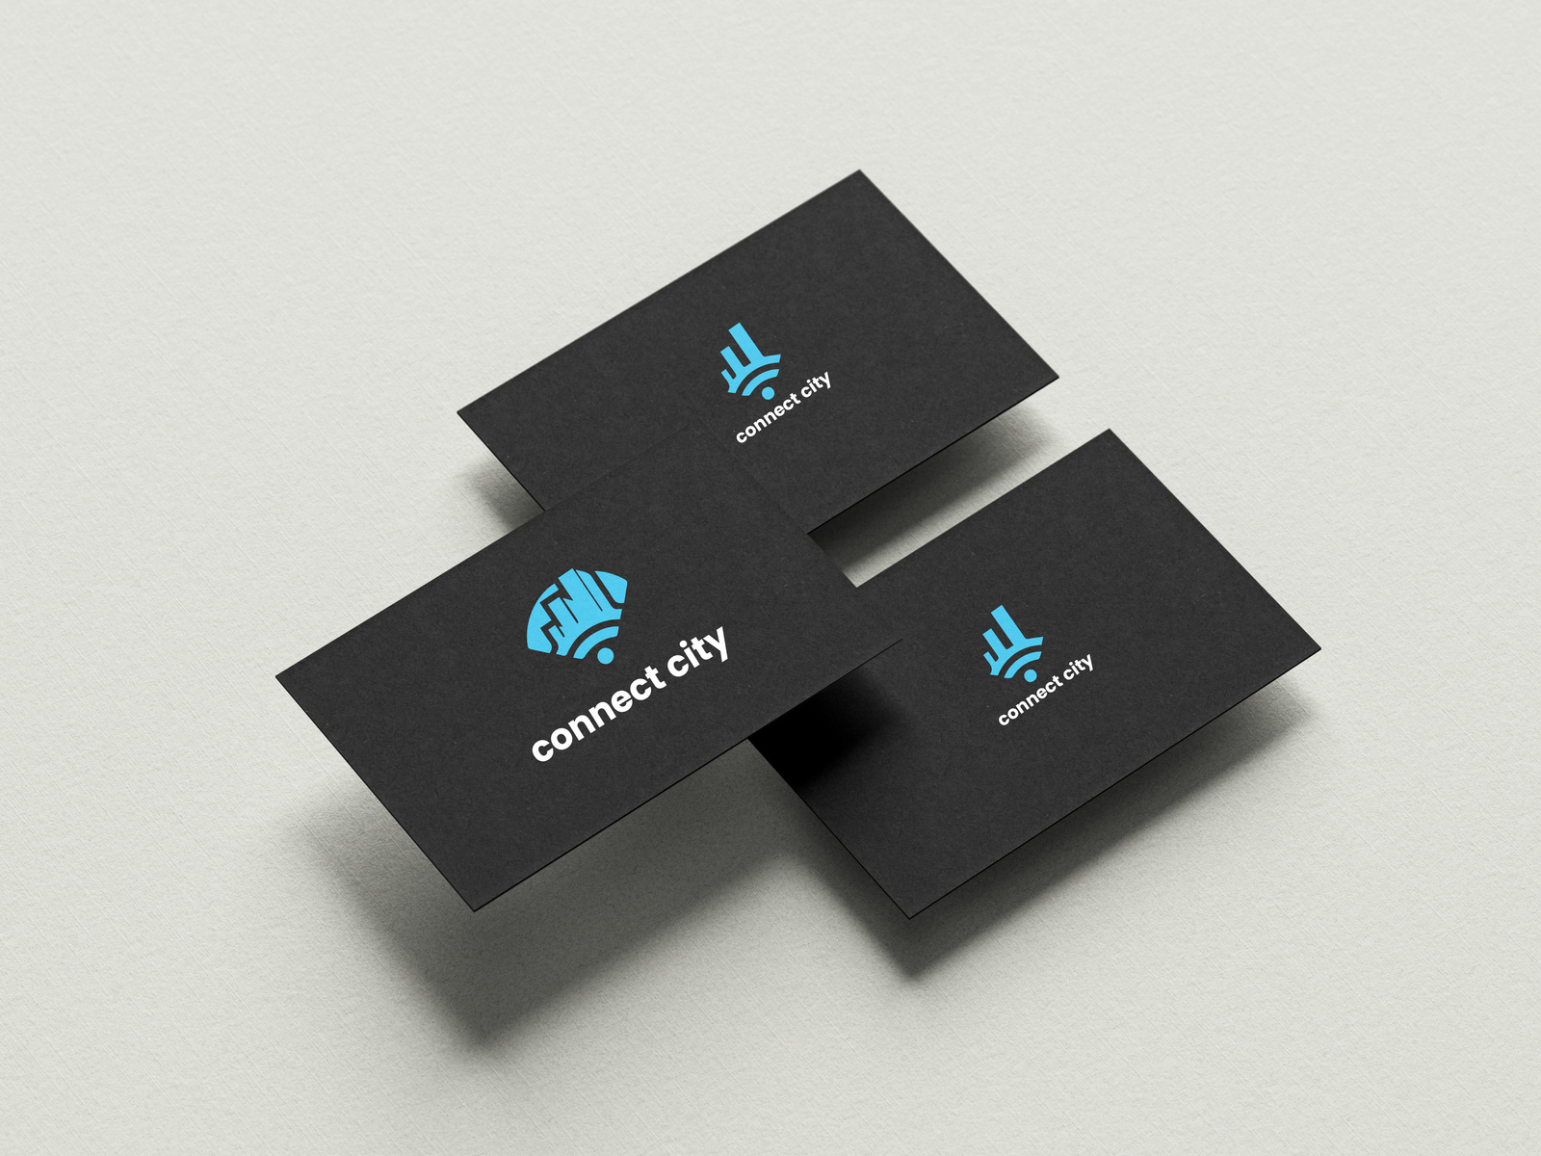
Our Business Card

Slide 7
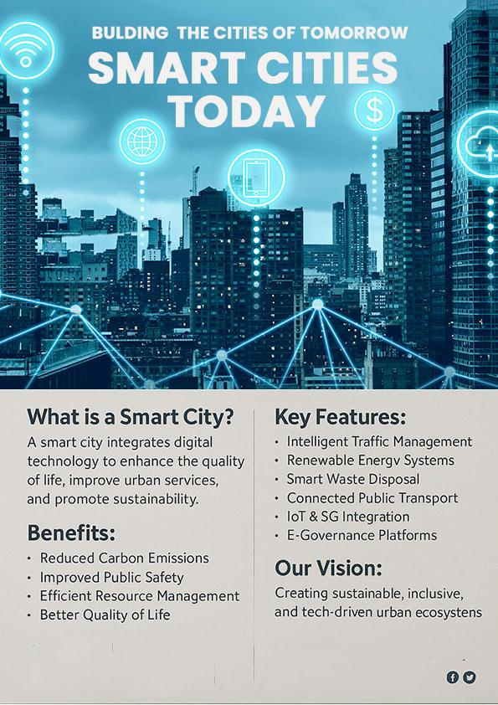
This infographic illustrates the concept of smart cities, highlighting their key features and benefits using modern visuals and digital icons.

Slide 8
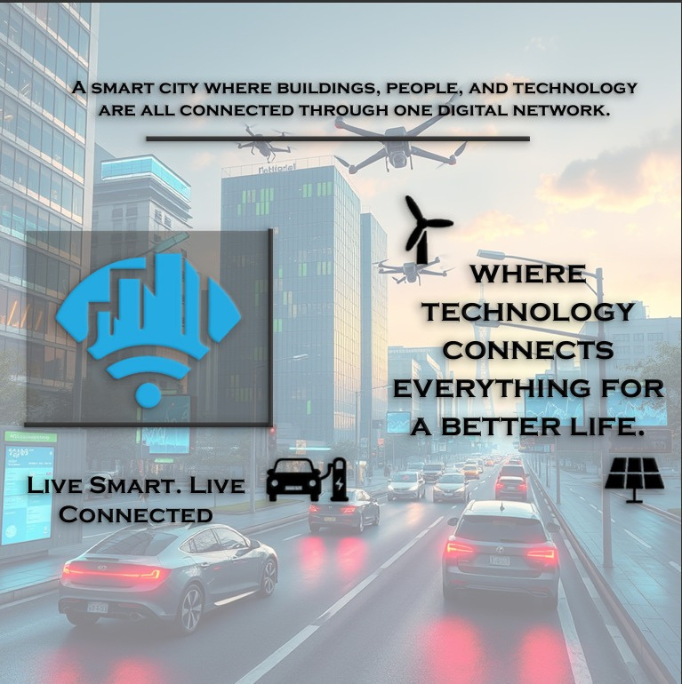
This poster highlights our main logo and slogan.
It focuses on the idea of a smart city where technology connects everything (people, buildings, and systems) to improve everyday life .

Slide 9
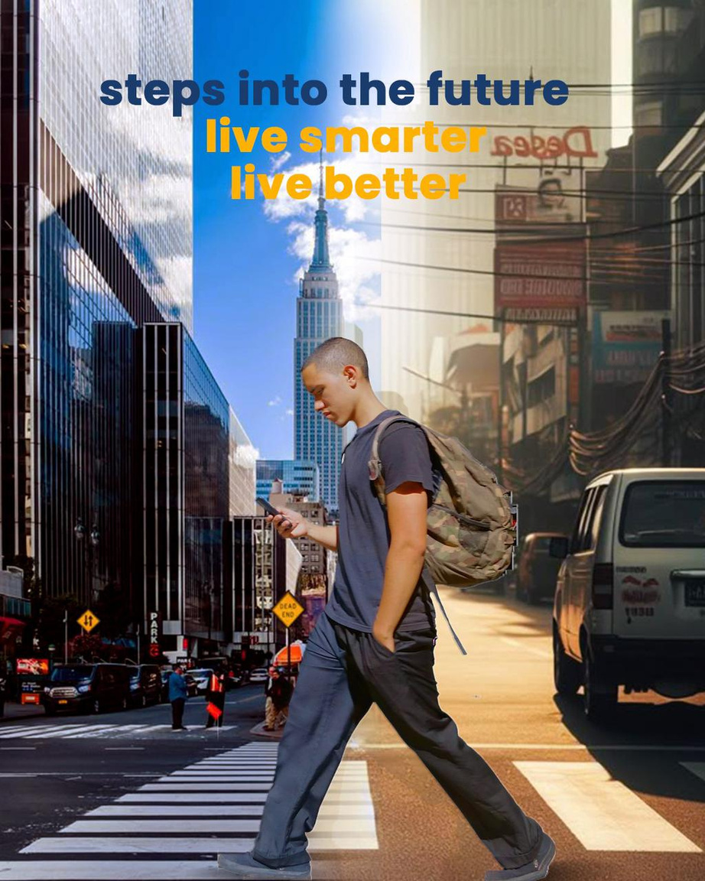
The design shows a visual contrast between traditional and smart cities, symbolizing progress and the journey toward a more advanced urban .

Slide 10
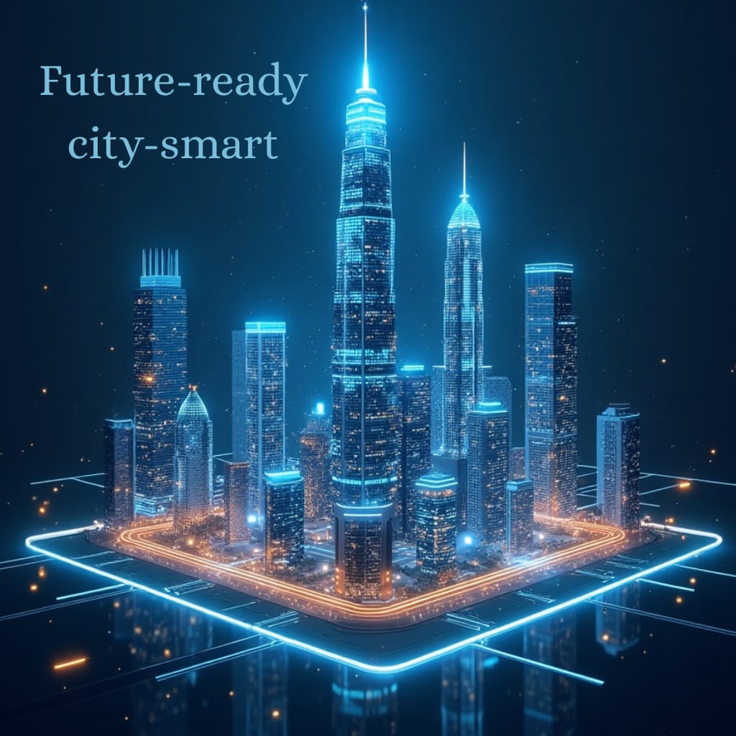
This poster depicts a futuristic smart city illuminated in vibrant blue and orange lights, symbolizing advanced technology and digital infrastructure. Towering skyscrapers and glowing circuits highlight innovation, connectivity, and the integration of modern architecture with smart systems.

Slide 11
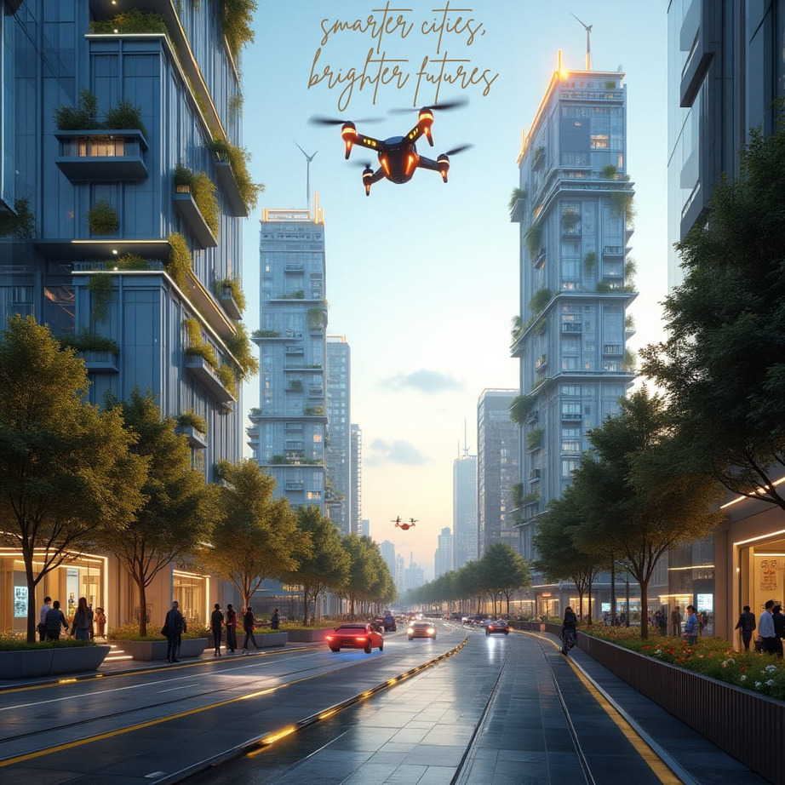
"Smarter cities, brighter futures"
This slogan suggests that by making cities more intelligent through technology, we can create a better, more sustainable future for everyone.

Slide 12
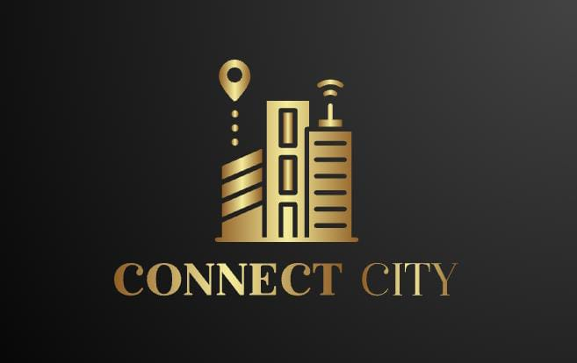

This sleek and modern logo design represents "Connect City" with a golden cityscape icon symbolizing connectivity through digital infrastructure. The combination of location pin and wireless signal elements conveys smart technology integration in urban development. Ideal for presentations related to smart cities, urban innovation, or tech-driven community solutions

Slide 13
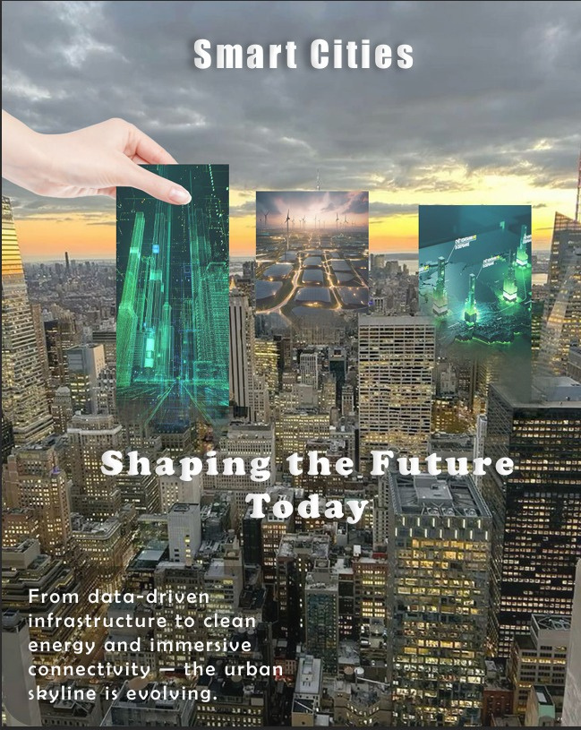


This poster focuses on how smart cities are already becoming part of our lives.
The message “Shaping the Future Today” shows that these changes are happening now, not later.
I included words like energy, data, and connection to show the key parts of a smart city.

Slide 14

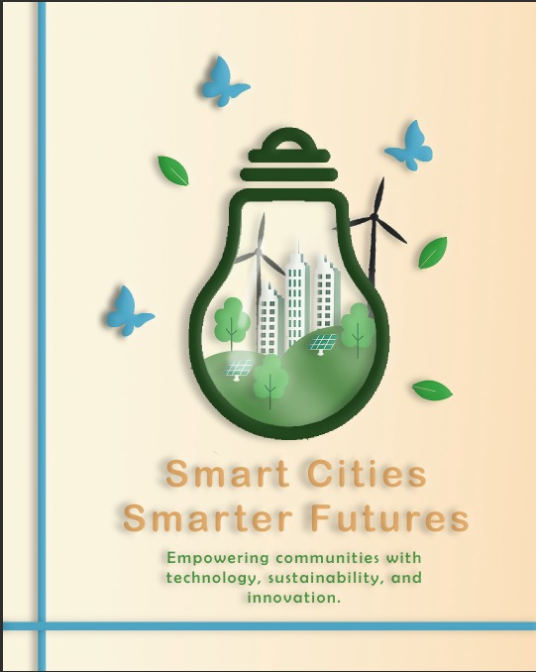
I created this poster to show how smart cities can improve the way we live.
The slogan “Smart Cities, Smarter Futures” highlights the idea of moving toward a better, tech-driven future.
I used clean visuals and a modern style to reflect the concept of innovation and progress.

Slide 15

This poster shows our eco-friendly vision—combining modern cities with nature. The message highlights working together for a greener, better future.

Slide 16
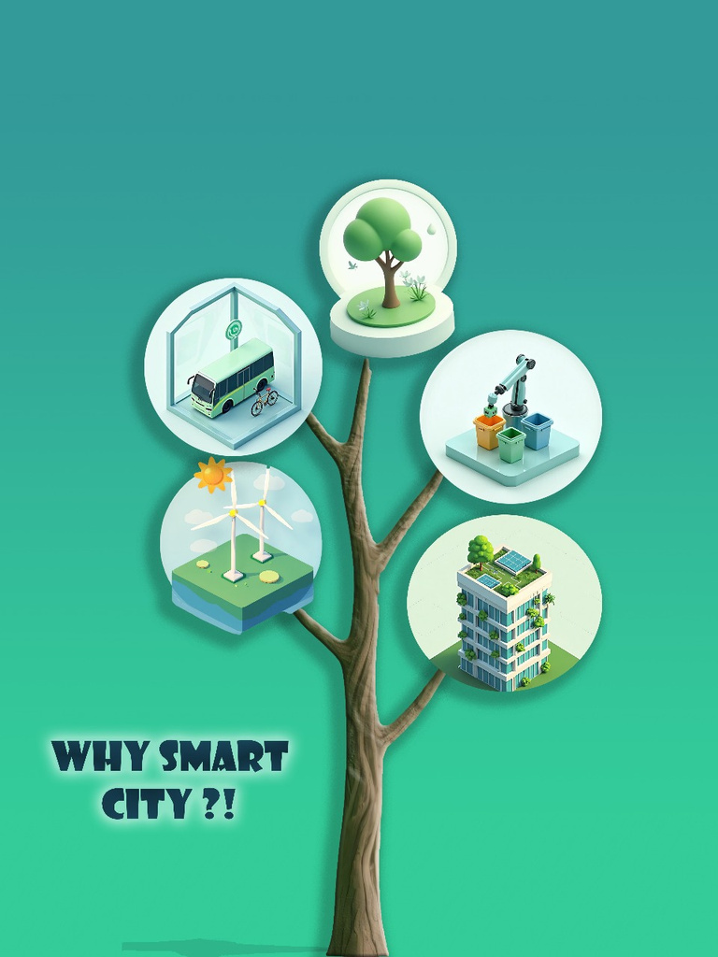
This poster explains the benefits of smart cities. It shows how we use green energy, smart transportation, clean buildings, and eco-friendly systems to protect the environment and improve daily life. The tree shape symbolizes growth and connection between all these smart solutions.

Slide 17
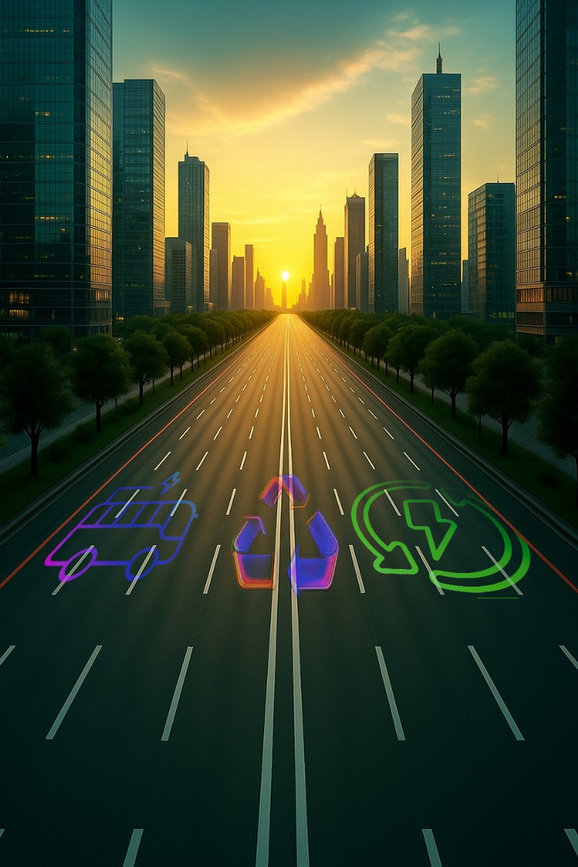
This poster powerfully captures the vision of a sustainable smart city. The empty, clean highway leading into a glowing sunrise represents a hopeful future built on innovation and environmental responsibility.

Slide 18
APPLICATIONS WE USED :
Adobe Photoshop
Adobe Illustrator

Slide 19


